Slide 1
BUPT Model Modification
Liu Yitong, Liu Hao, Ran Yu, Wang Zhe
liuyitong@bupt.edu.cn
WT&T Lab @ BUPT

Slide 2
Outline
UCSD Model Re-Validation
- Results of UCSD Model improve when data updated.
- PCC turns out to be 0.8785 with the subjective scores from UCSD, rather than 0.91.
- Subjective results from BUPT disagree with those from UCSD.
BUPT Model
- A series of basic model tested.
- Polynomial stands out.
- Three factors(Initial Delay, Stall, Level Variation) are independent of one another to some extent.
Notes:
UCSD Model Re-Validation
- 数据更新后，UCSD模型准确度有所提升，但并不理想
- UCSD主观分数得出的模型PCC为0.8785，与之前的0.91不符
- BUPT主观测试分数与UCSD主观测试得分存在一定差异
BUPT Model
- 测试了一系列基础模型
- 多项式形式非线性回归模型表现较好
- 三个因素（初始时延、卡顿、质量变化）对于整体得分的影响相 对独立

Slide 3
UCSD Model
R = f(I_{ID}, I_{ST}, I_{LV})
Impairment due to Initial Delay
Impairment due to Level Variation
Impairment due to Stall
C₁ | C₂
0.17 | 0.31
Result of UCSD
PCC : 0.91
MSE : 0.082
Result of BUPT
PCC : 0.6998
MSE : 0.5895

Slide 4
UCSD Model Re-Validation
Conclusion：
PCC and MSE of UCSD Model improve when objective data updated.
Subjective results from BUPT disagree with those from UCSD. (MSE is high.)
Type Factor | BUPT | UCSD | Subjective Results between BUPT & UCSD
PCC | 0.7811 | 0.8785 | 0.8141
MSE | 0.4267 | 0.2873 | 0.4077
Notes:
客观数据更新后，UCSD模型表现有所提升（见BUPT栏）
UCSD与BUPT主观测试得分契合度不高（PCC并不好，且MSE很高）

Slide 5
UCSD Model Re-Validation
Problem：
The accuracy of UCSD model is still not ideal enough after the data revision.
PCC of UCSD model turns out to be 0.8785 when verified with subjective results from UCSD, which is not as high as 0.91.
Type Factor | Before | After
PCC | 0.6998 | 0.7811
MSE | 0.5895 | 0.4267
 | Results UCSD provided | Recalculation Results
PCC | 0.91 | 0.8785
MSE | 0.082 | 0.2873
Results before and after the subjective scores updated
Recalculation Results
Notes:
更新数据后，模型准确度也并没有非常理想
使用UCSD自身数据验证模型，结果并没有达到足够高的拟合度

Slide 6
Model Validation & Comparison
PCC and MSE aforementioned show that BUPT’s test results don’t agree with the UCSD Model very well.
64 testers from BUPT participate in the subjective test, 25% more than UCSD’s.
Result filtering according to ITU-R BT.1788 were made to guarantee the accuracy of our subjective results.
Further researches were made to modify the formula on the basis of BUPT’s subjective test results.

Slide 7
Polynomial Model (1)
m1 | 2
m2 | 2
m3 | 2
Iterations | 1 | 2 | 3
PCC | 0.6356 | 0.7868 | 0.8017
MSE | 0.7543 | 0.5002 | 0.4753
m1 | 2
m2 | 2
m3 | 0.5
Iterations | 1 | 2 | 3
PCC | 0.8126 | 0.8049 | 0.8121
MSE | 0.4718 | 0.4875 | 0.4654
m1 | 2
m2 | 0.5
m3 | 0.5
Iterations | 1 | 2 | 3
PCC | 0.8748 | 0.8720 | 0.8688
MSE | 0.3944 | 0.3936 | 0.3891

Slide 8
Polynomial Model (2)
m1 | 3
m2 | 3
m3 | 3
Iterations | 1 | 2 | 3
PCC | 0.53 | 0.7950 | 0.665
MSE | 0.8063 | 0.5967 | 0.5867
m1 | 4
m2 | 4
m3 | 4
Iterations | 1 | 2
PCC | 0.7646 | 0.7543
MSE | 0.5249 | 0.5390
Coefficient Calculation*: Nonlinear Regression Method.
Notes:
系数计算*: 上述模型验证使用的是训练-预测的方法，后面预测模型采用的是非线性回归方法

Slide 9
Exponential Model (1)
k1 | 1
k2 | 1
k3 | 1
Iterations | 1 | 2 | 3
PCC | 0.7836 | 0.7830 | 0.7847
MSE | 0.5210 | 0.5261 | 0.5219
k1 | 2
k2 | 1
k3 | 1
Iterations | 1 | 2 | 3
PCC | 0.8001 | 0.7848 | 0.6751
MSE | 0.5032 | 0.5185 | 0.5299
k1 | 2
k2 | 2
k3 | 1
Iterations | 1 | 2
PCC | 0.8038 | 0.6774
MSE | 0.5126 | 0.634

Slide 10
Exponential Model (2)
k1 | 3
k2 | 3
k3 | 3
Iterations | 1
PCC | 0.8013
MSE | 0.5338
k1 | 4
k2 | 4
k3 | 4
Iterations | 1
PCC | 0.7952
MSE | 0.5634
k1 | 5
k2 | 5
k3 | 5
Iterations | 1
PCC | 0.7966
MSE | 0.5584

Slide 11
Conclusion
PCC of Polynomial Model is higher than other basic elementary functions when m1=2, m2=m3=0.5.
The higher the power is, the lower the PCC will be
Changes in exponent do not affect the PCC distinctly.
Impairments by Stall and Level Variation hurt more than the Initial Delay Factors.
Notes:
多项式比较好，PCC高于指数形式的模型
多项式的幂次高了PCC变低
指数变化对PCC影响不明显
根据多项式看，ST和LV的损伤影响大于ID

Slide 12
Relevant Model
Iterations | 1 | 2
PCC | 0.734 | 0.723
MSE | 0.594 | 0.503
Three factors (initial delay, stall and level variation) are independent of one another to some extent.
PCC decreases when items used to eliminate the interaction between Stall and Level Variation is added.
Notes:
三个因素在一定程度上是相互独立的，增加消除因素间相互影响的项后并没有表现得更好。

Slide 13
Modified Model (1)
 | For R
PCC | 0.8782
RMSE | 6.367
Modified Model is in the form of polynomial. There is an item for eliminate the correlation between Stall and Level Variation.
Results are updated with the objective scores up to date. PCC of former data was 0.887.
Notes:
根据之前的结论模型形式，再增加卡顿及质量变化的相关项后得出上述结果，是目前形式简单且相关性较好的一个模型公式
目前测试模型均使用的是更新后数据，针对更新前的数据PCC可达0.887

Slide 14
Modified Model(2)
 | Movie (48) | All (96)
PCC | 0.9441 | 0.8782
RMSE | 4.6662 | 6.367
PCC and RMSE of the 48 movies (low motion) perform better compared with all(96) videos.
Results are calculated in the form of R (testers’ score), rather than MOS.
Notes:
模型结果针对的是视频得分R的非线性回归准确度，而非MOS得分，二者有标准公式可以转换
我们发现，与未区分motion的UCSD模型相比，该模型对于UCSD提供的低速运动视频（前48部）的拟合度明显提高，PCC与MSE均变好

Slide 15
Modified Model(3)
 | Average(48 movies) | Movie 31
RMSE | 4.6662 | 21.8847
 | movie(48) | movie(47)
PCC | 0.9441 | 0.9681
RMSE | 4.6662 | 3.2805
There are many 0 in the original scores of Movie31.
Possible Reason: In front of Movie31 is Movie09 in Sheet1, of which the quality is high.
Notes:
Movie 31 出现了部分0分

Slide 16
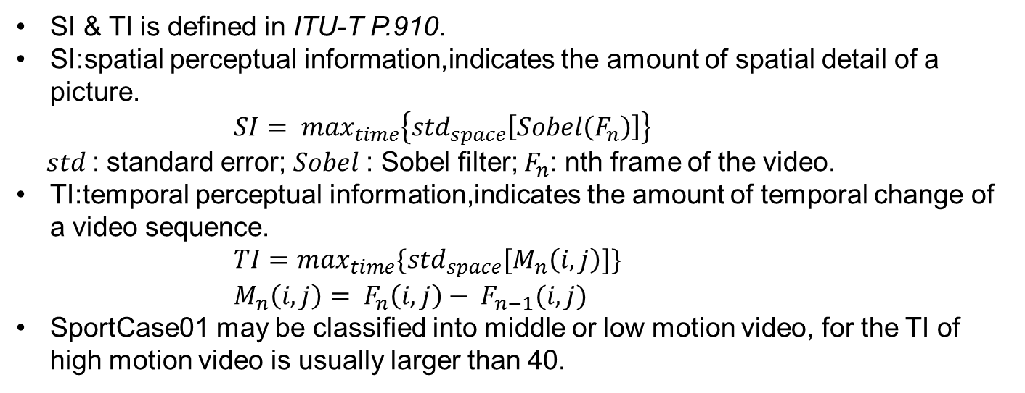
Motion Classification
 | BunnyCartoon1 | BunnyCartoon2 | BunnyCartoon3 | MovieCase01 | MovieCase02 | MovieCase05 | SportCase01 | SportCase02
SI | 85.168 | 100.60 | 78.267 | 86.571 | 93.174 | 86.836 | 81.164 | 99.266
TI | 51.240 | 78.420 | 49.755 | 52.378 | 59.443 | 52.572 | 33.577 | 41.817
SI & TI is defined in ITU-T P.910.
SI:spatial perceptual information,indicates the amount of spatial detail of a picture.
$SI= \max_{time}\left\{{std}_{space}\left[Sobel\left(F_{n}\right)\right]\right\}$
$std$: standard error; $Sobel$: Sobel filter; $F_{n}$: nth frame of the video.
TI:temporal perceptual information,indicates the amount of temporal change of a video sequence.
$TI=\max_{time}\{{std}_{space}[M_{n}\left(i,j\right)]\}$
$M_{n}\left(i,j\right)= F_{n}\left(i,j\right)− F_{n−1}(i,j)$
SportCase01 may be classified into middle or low motion video, for the TI of high motion video is usually larger than 40.

Slide 17
Thank you!

